Slide 1
AirBnb and Trust Networks
Letian Kong & Dakota Schey

Slide 2
A Quick Re-cap of the Project Layout
To begin, we are utilizing Professor Abrahao’s dataset from his experiment “Reputation offsets trust judgments based on social biases among Airbnb users” and repurposing it for the purpose of our experiment.
The data consists of 20 different variables generalized into 4 different concepts:
Demographic data regarding the human investor (age, gender, marital status, etc.)
“Homophily Inducers” - how responses vary between the humans and robot profiles
Robot (“investee”) demographic variables as a distance measurement
Investment (outcome variable)
By “distance”, we refer to the amount of variables differences that exist between the human and robot profiles.

Slide 3
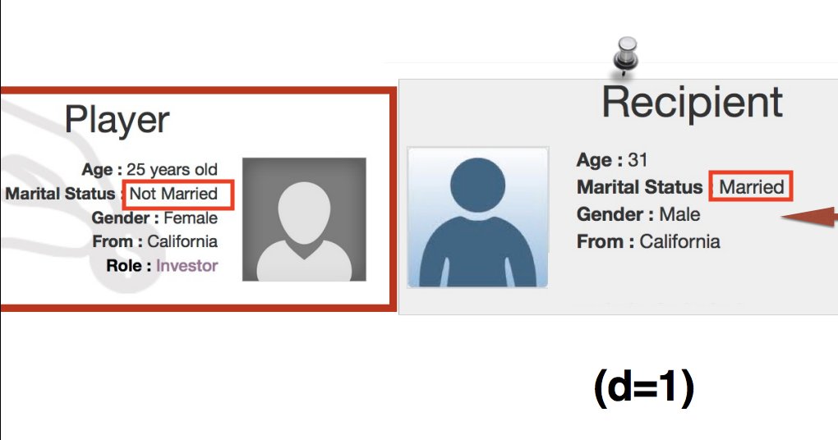
Example of Distance
Notice that the only difference between the investor (human) and investee (robot) profile is “marital_status”. This sole difference implies a “distance” = 1

Slide 4
Project Reconfiguration
Initially, we had planned to develop some sort of recommendation algorithm by clustering participants, analyzing covariate relationships and creating enhanced homogeneous networks based on robot distances.
However, we decided to instead emphasize on the impact that combined robotic diversity and covariate analysis can play in the trustworthiness individuals when making loss-inducing decisions.
What do we mean by this?

Slide 5
Our Thought Process
We have proposed (and want to carry on the experiments that were lead by our Professor, Bruno Abrahao) to analyze the differences that individuals (investors) may posit between the robotic “investees” as a distance measurement.
Would increasing the distance between the humans and robots by altering (1, 2, … n) variables impact how likely, and just how much these users would invest?
How different are humans likely to invest in a robot of a certain category (male, Colorado, 30, etc.)
How does more diversity in terms of a certain characteristic (age, gender, marital status, etc.) impact investment behavior (compare the impact of “age” differences that exist between a married, male from Colorado and a married, male from California on trust/investment amount)
By understanding and trying to answer these questions, we can gauge trust by understanding covariation within this “shared economy” network

Slide 6
Experimentation Process
Hypothetical Research Question:
How will the gender of a robot intertwined with the overall demographic gender display of a group (remember that there 5 robots compared side-by-side as a “group”) impact trustworthy decision making? This same concept is repeated for marriage and marriage diversity as well.
Experimentation on our end consisted of several steps:
Initial Data Analysis
Data Modification and Data Engineering
Robot Profile and Networking
Robot Profile Analysis
Predictive Modeling

Slide 7
Initial Data Analysis
The dataset itself consisted of about 33,000 rows and 20 columns
However, to utilize this data in order to make any conclusions according to game design, we needed to check if any participants had robot distances that deviated from the general format of [0,1,2,4,5]. We found that 2, and removed them in order to generate our robot profiles correctly.
The culprit participants:
126 & 26,326

Slide 8

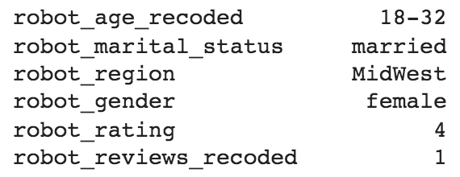
Data Modification & Data Engineering
The first we had to do for this aspect of our project was to conglomerate different variables into more refined groups. For example:
Converting individual robot ages into varying age ranges:
18-32, 33-46, 47-60,>60
We did this step for the robot reviews as well:
1, 2-3, many
Then, we isolated all of the 560 possible robot combinations that existed, and for each individual participant ID row in our dataframe, we labeled which unique robot combination exists.

Slide 9
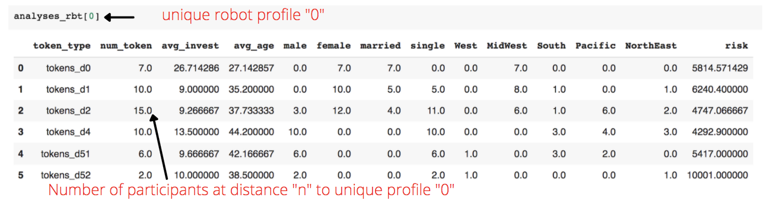
Robot Profile and Networking
From there, we group_by robot_id to obtain an edgelist data frame that we then used build a network graph for each robot profile. We can analyze each robot profile and then categorize the participants based on their social distances to these robot profiles.
This information was all stored in a data frame, and by adding:
Attribute/demographic information of each token
Average Age and average Risk calculations (calculated by dividing by number of particular tokens)
We can then see which participants invested in a unique robot profile:

Slide 10
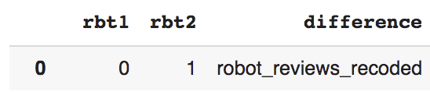
Robot Profile Analysis
The next input in our model involved creating a network that consists of the 560 unique robot profiles; each unique robot is a node and the “comparability” of each profile are the edges
Because it is difficult to compare robot profiles among 6 potentially differing attributes, we made the robot profiles “comparable” if the two robots only differ in terms of ONE variable.
We go on to create an edge list model that compares each unique robot pair match (how many different combination edges we can create through the 560 unique robot pairs) and the varying 0-5 distances between them. With this, we see about 156,520 different combinations.
The next step in our edge list model involved building various functions to uncover which of the difference(s) exist between the robot pairs among the 156,520 combinations.
This will allow us to utilize the various value counts of each difference and attribute some sort of “investment” value to these robot pair differences.

Slide 11
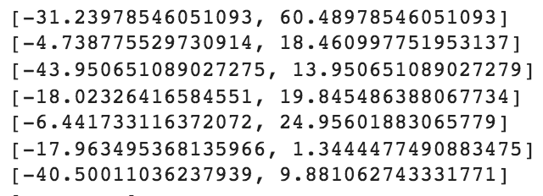
Robot Profile Analysis Pt. 2
Output: Mean differences in terms of “Investment Amount”
Compare how investments differ between participants who are distance 0 (d=0) away from each other when the two robots differ in gender:

Slide 12
Predictive Models
Initially, we ran three models that focused solely on robot profile characteristics:
Linear Regression (RSME: 12.59)
Regression Tree (RSME: 12.69)
Catboost (RSME: 12.44)
Based on these RSME values, we were able to predict how much trust/investment that a investor made in a robot that was “x” distance away from him/her based on the correlation of certain features.
However, because we found this information rather inconclusive because in real life, we would need to apply other information besides the robot demographics. By having the option to invest in multiple available robot profiles that differ based on distance, the decision to invest/trust a profile is latently affected by other attributes that may exist in one of the other robot profiles that exists.

Slide 13
Predictive Models
Thus, we created a new, improved Linear Regression model that includes some new variables to help enhance the predictive probability and “diversity” aspect of our model. For example, even if more females correlate to higher trust or investment amount, what happens if all of the females contain another attribute that is negatively correlated to trust or investment amount? These issues can be alleviated by adding certain variables below:
Environmentally Sensitive:
Variance of Robot Age
Percent of Robots Male
Unique Regions among Robots
Percent of Robots Married
Participant Features:
Participant Gender (adding participant feature)
Participant Marital Status (adding participant feature)
Intersection Features:
Gender Diversity (intersection variable)
Marriage Diversity (intersection variable)

Slide 14
Finalized Regression Model Output
Some conclusions from the finalized linear regression model:
A robot’s age, robot gender and robot region, robot rating, robot distance and robot review all have an effect on the investment amount
The distance between robot and investor also has an effect on the investment amount
The environmental factors, the age variance (diversity) has a small, negative effect on investment. As the age of profiles becomes more diverse, the amount of investment will decrease.

Slide 15
Finalized Regression Model Output
Some important insights from the finalized linear regression model:
There is an interactive effect of gender and gender diversity and another interactive effect of marital status and marital status diversity.
If a certain robot is male, for every one more male robot that co-exists with this “certain” robot, the amount of investment this certain robot receive will increase by 0.71.
If a certain robot is single, for every one more married robot that co-exists with this “certain” robot, the amount of investment this certain robot receive will decrease by 0.74.

Slide 16
Real World Business Applications & Future Improvements
Based on the results from our experiment, we would hope that these insights can be applied in a real world setting. For example, understanding how these covariates interact in a group setting can be key to understanding customer behavior. Imagine targeting a diverse group with advertisements…
How would the diversity of the group influence trust in a shared marketplace?
How would changing the ratio of males/females in the group setting impact the likelihood of making a purchase decision?
These sort of questions are incredibly valuable to understand when considering the complexity within the marketing and advertising realm, especially when analyzing many, often non-homogenous individuals. With some clustering, hopefully applied in the future, we can better uncover the latent representation that demographics can have on our outcome.
Our analysis can hopefully help answer and expand upon this inquiry:
“With limited amounts of sellers able to be displayed on the AirBnb app to users, how will the grouping of demographically (similar/different) displays most impact the likelihood of purchasing?”

Slide 17
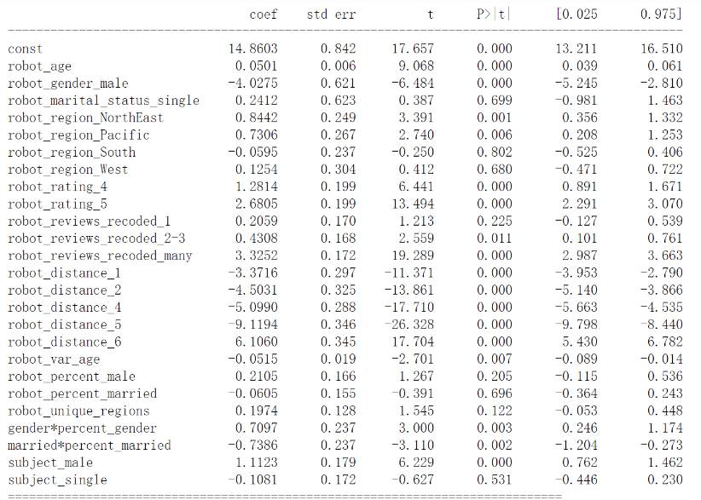
Appendix. Regression Model Summary

